Slide 1
ISSUES INVOLVED IN ENFORCEMENT OF ENVIRONMENTAL LEGISLATION

Slide 2
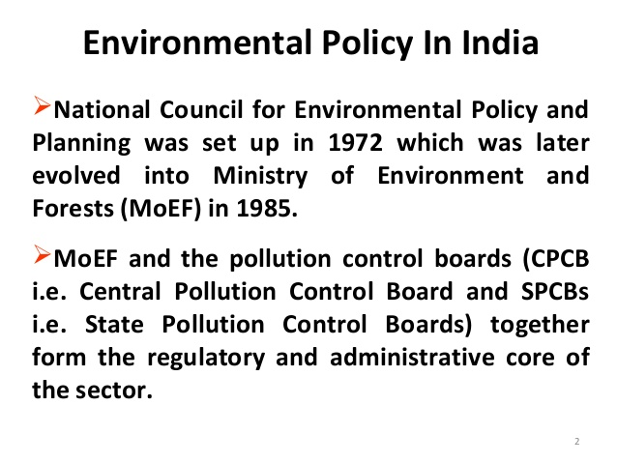

Slide 3
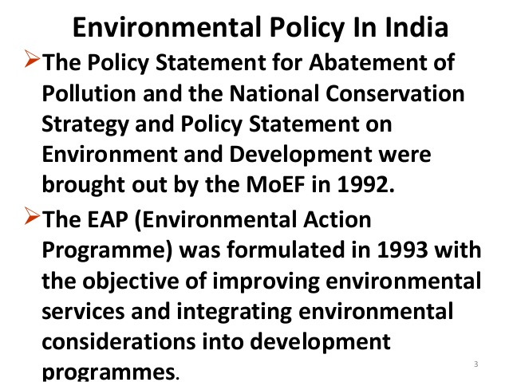

Slide 4
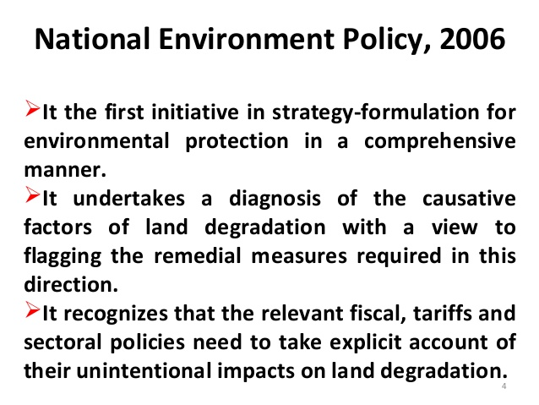

Slide 5
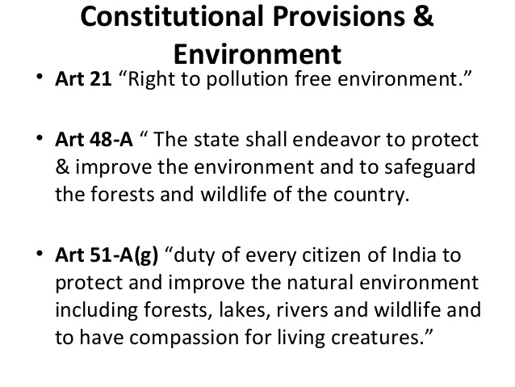

Slide 6
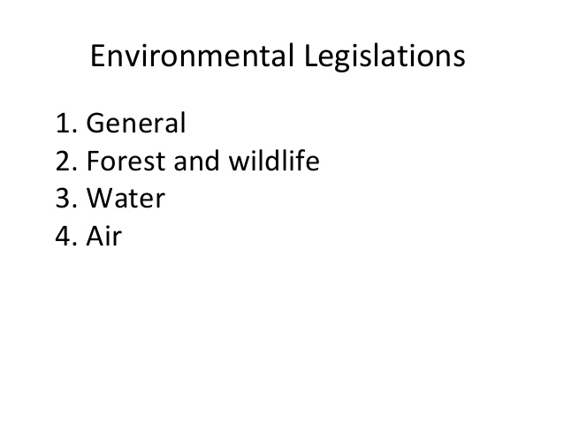

Slide 7
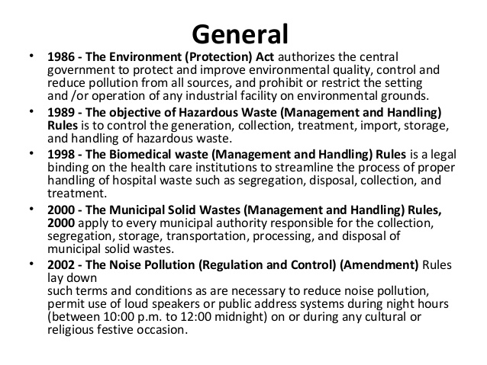

Slide 8


Slide 9
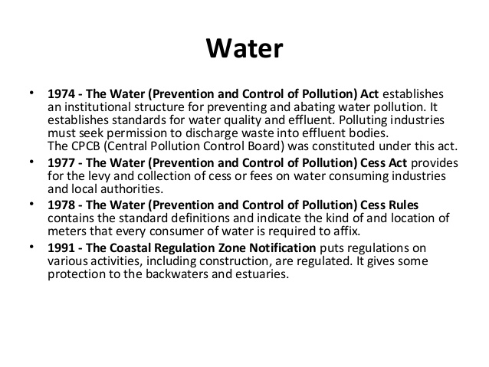

Slide 10
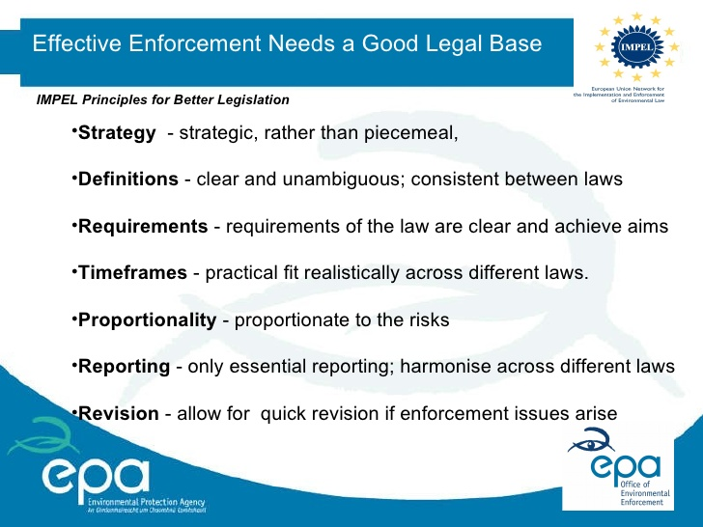

Slide 11
Government of India has taken a large number of steps in constitutional, legal and administrative fields, in order to protect the environment from further degradation and pollution.
In spite of such efforts made on part of both the central and state Governments, the problem of environmental degradation and pollution has not been controlled to the extent to which in can be.
The fault must lie with the institutional set-up or with the people, or with both.

Slide 12
1) Paper Initiatives and Little Achievements
2) Less effective control Measures: Over the last decade, though new legislative enactments related to the environment have paved the way for protection of environmental resources, yet several problems still persist.
The question is that why no perceptible steps have been taken by the authorities for their enforcement.
3) No uniformity of Implementations: Some legislation point of view, some loopholes in the Acts hinder the progress of implementation.
For instance: Acts have been passed to control the air and water pollution, but they lost their significance in the absences, similar in case noise pollution.
4) Too much of laws handling: With the coming into force of the environment (protection) act 1986 in November, the government succeeded.

Slide 13
Implementing soft in nature:
Research Findings not implemented
Absence of co-operation
Limited Recognition of NGOs
Less Financial Support

